Slide 1
Outliers Detection in NewYork’s Subway Ridership
Supervised By: PROF. MICHAL XYNTARAKIS
Name : JASH SHAH

Slide 2
Project Description
Our Purpose to work on New York’s ridership is to use data analytics techniques to find out the
Outliers in the Subway ridership and to analyze the existing current state of the art using different
Data analysis and machine learning techniques.

Slide 3
PROBLEM STATEMENT
Although there are many advantages of Subway ridership all around the world, issues remain in many areas of the transit systems such as unusual activities, dependability, safety, and rider satisfaction.
According to the 2015 MTA Customer Satisfaction Survey (MTA 2015), only 74% of trips are completed on time, while the MTA has an overall satisfaction rating of 83%.
These concerns compel transit providers to reform and get better
the purpose of this research is to find out the anomalies that may be present in the Transit data in order to make a better decision for the improvement of subway ridership in New York.

Slide 4
ML Algorithms Description
The ml algorithms that we have used are
CBLOF (Cluster Based Local Outlier Detection) : Small and large clusters are made using the KNN algorithm approach. Each cluster point distance from centroid of cluster is calculated
KNN : KNN works by finding the distances between a query and all the examples in the data, selecting the specified number examples (K) closest to the query, then votes for the most frequent label (in the case of classification) or averages the labels (in the case of regression).
Angle Based Outlier Detection: In this algorithm angle is used to find out detection rather than Distance.

Slide 5
ML Algorithms Description
The ml algorithms that we have used are
Isolation Forest: Used two Outliers characteristics to Isolated them: Minority in the datasets and different from rest of the values
Clustering : Arranging the set of Objects into one set of Group based on some common features
Patterns Recognition: Use of EDA and other statistical analysis techniques identify the patterns in the data.

Slide 6
01
Data Collection
02
Data Preparation
03
04
Data Profiling
Data Cleaning
Working Steps to Handle Data
05
Data Reduction
06
Data Transformation
07
Data Enrichment
08
Data Validation

Slide 7
01
Transformed Data
02
Correlation Matrix
03
04
Data Clustering
Build & Train Model
Research Work Steps
05
Results

Slide 8
Tools and Technologies
Microsoft Excel / CSV
Anaconda Framework
Jupyter Notebook
Python Libraries
Python Programming
Tableau Desktop / Tableau Public

Slide 9
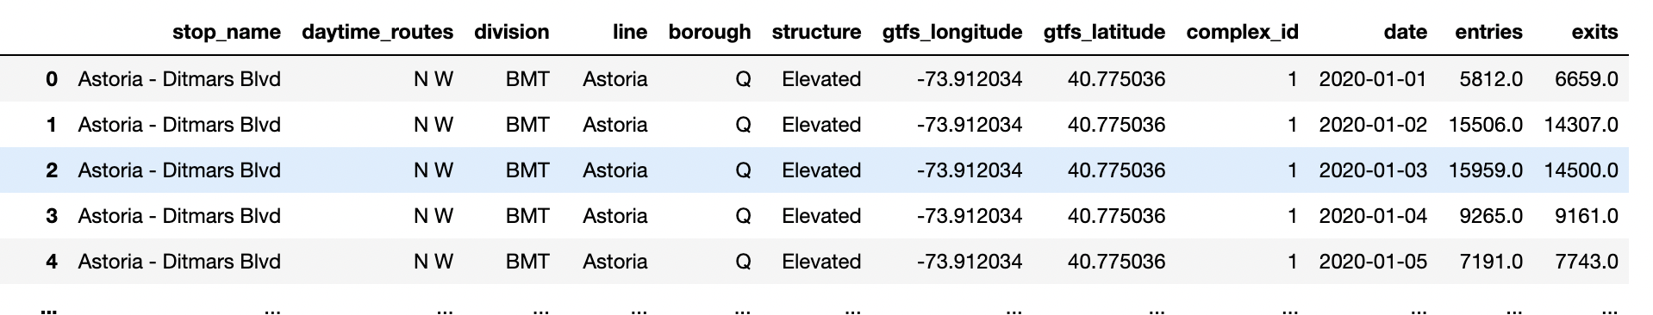
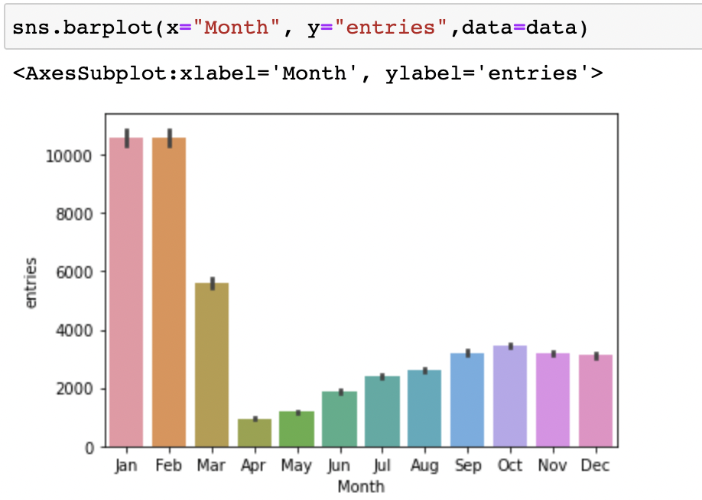
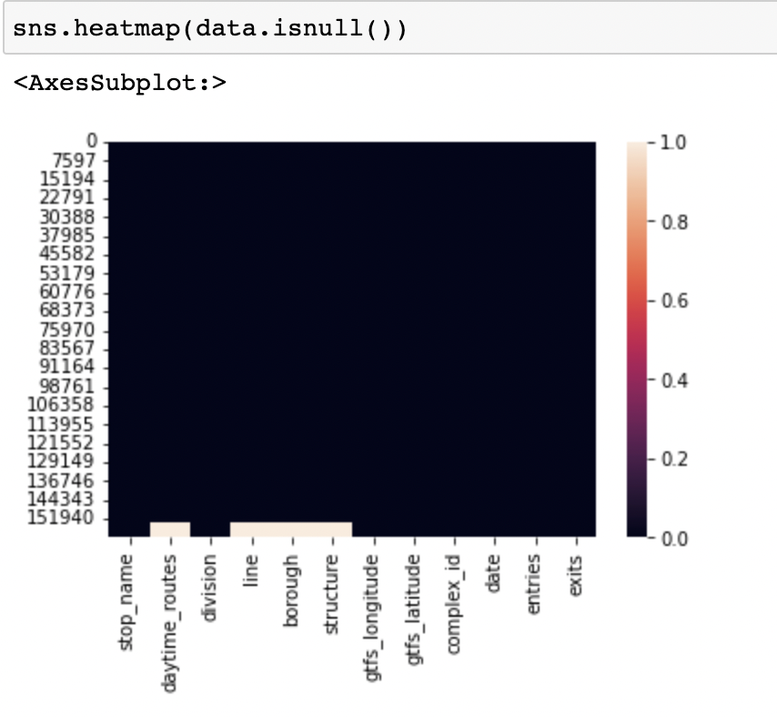
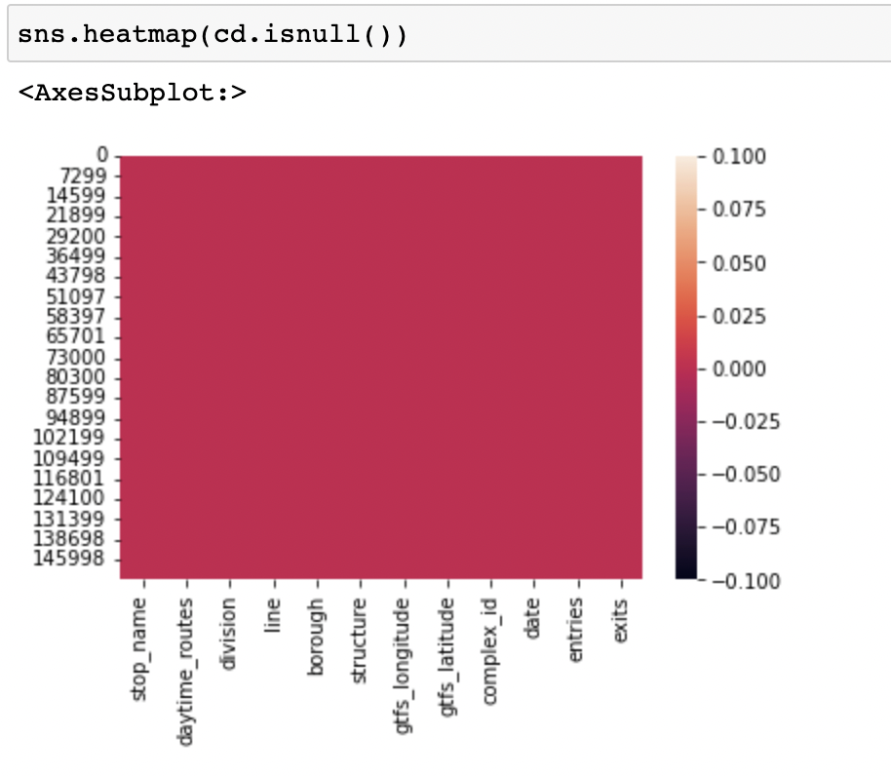
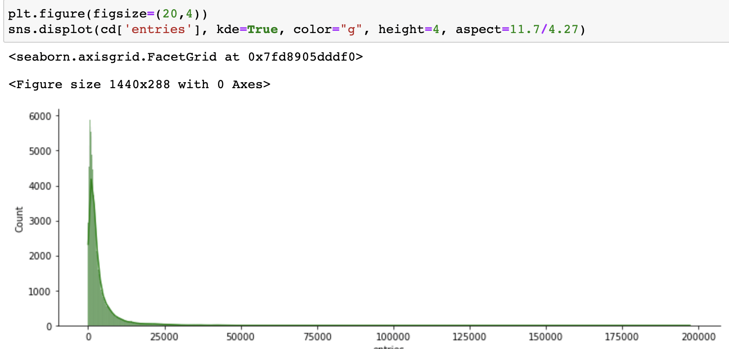
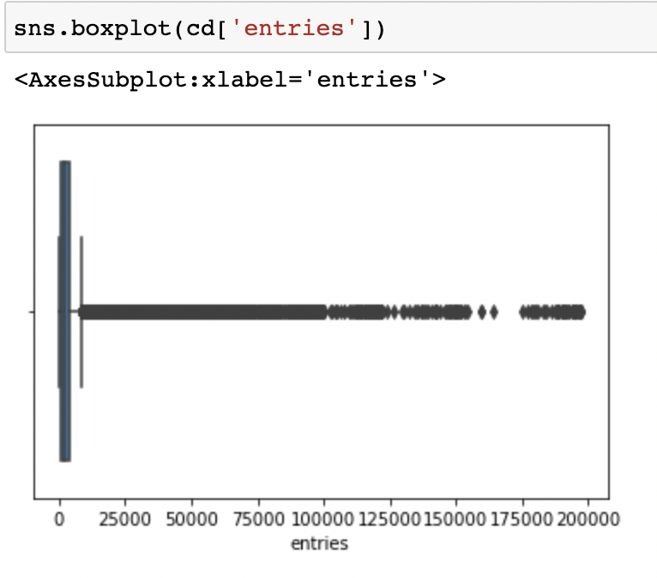
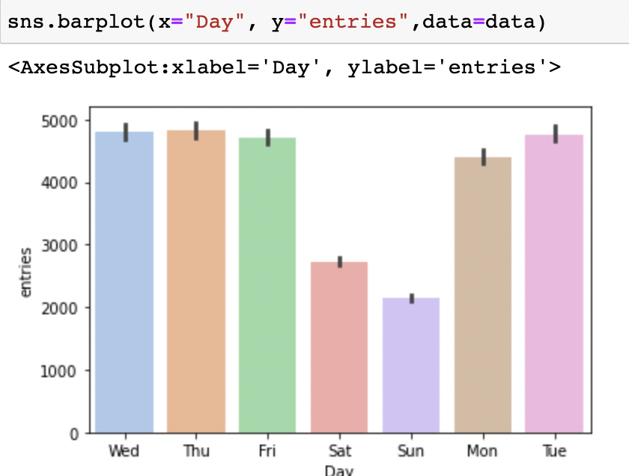
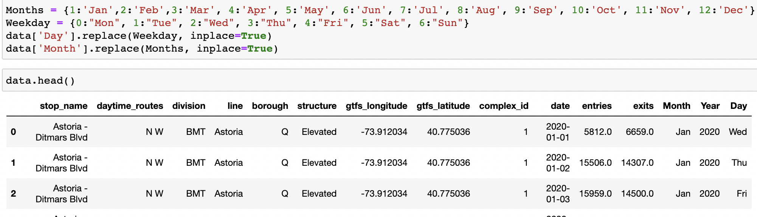
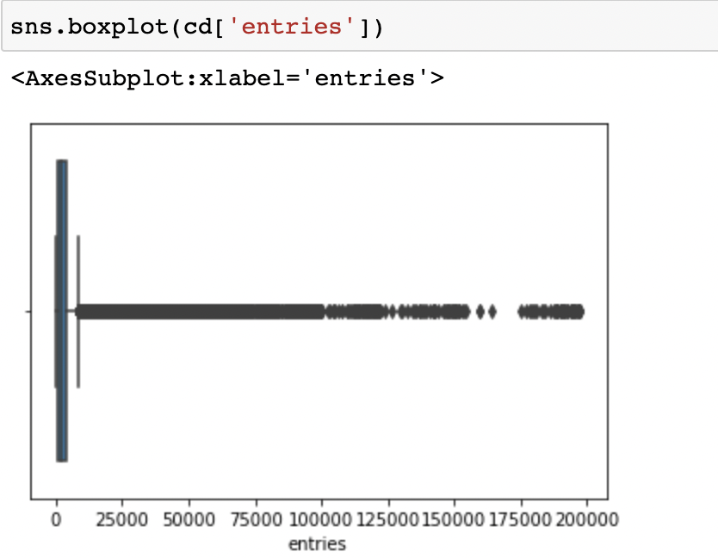
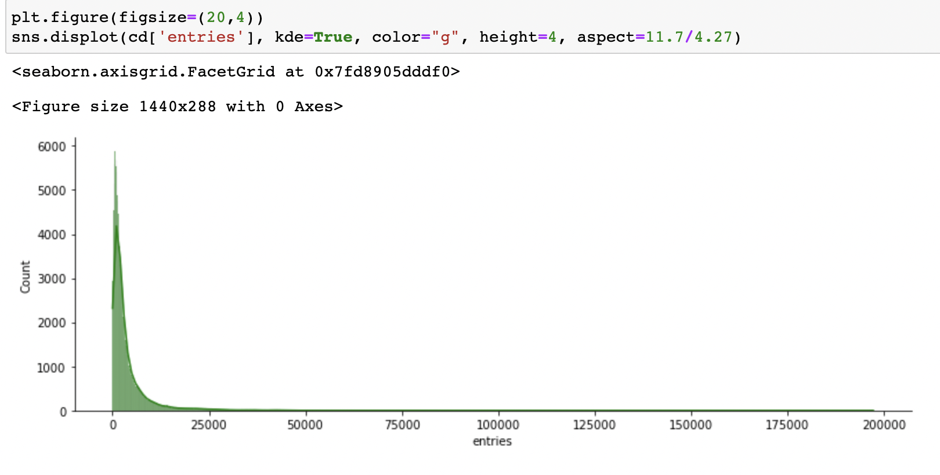
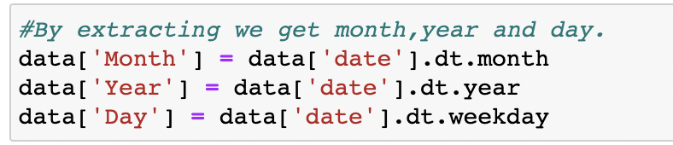
EDA ( Exploratory Data analysis )
Import library, read data, describe, summarize
Data cleaning process :
Plot heatmap to see for null values
Find null values: .isnull()
Drop : .dropna() them, and replot the heatmap, now it’s ready to use

Slide 10
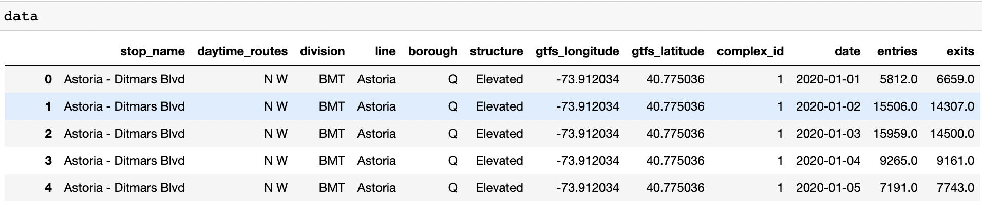
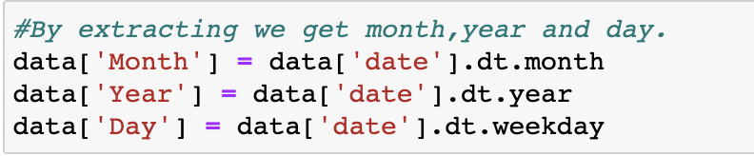
VISUALIZATION USING SEABORN AND PLOTLY
Converting Data type of date

Slide 11
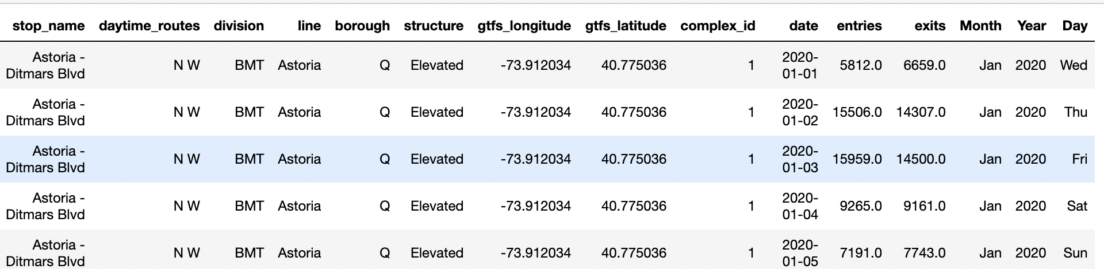
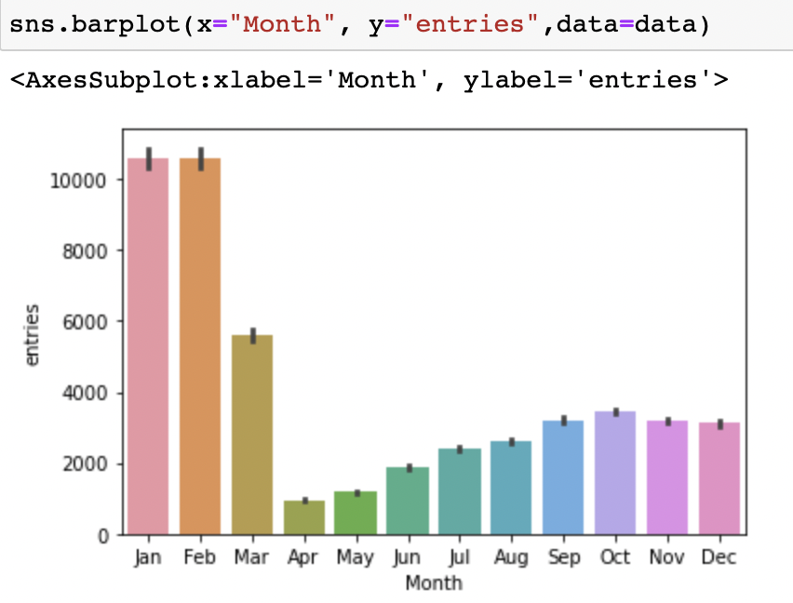
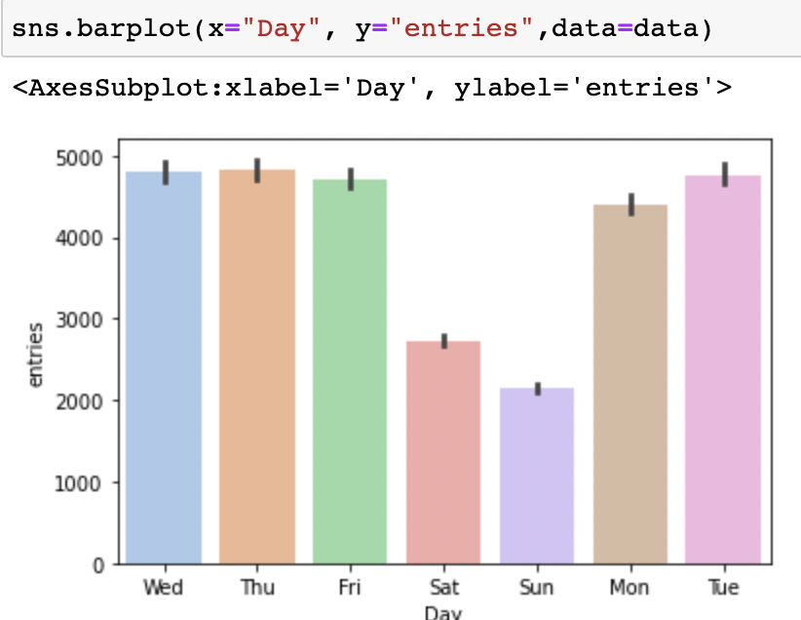
New table and Visual using seaborn

Slide 12
DETECTING OUTLIERS
Detected the outlier by plotting the box plot.
Plot .displot using seaborn to check for the distribution of the dataset

Slide 13
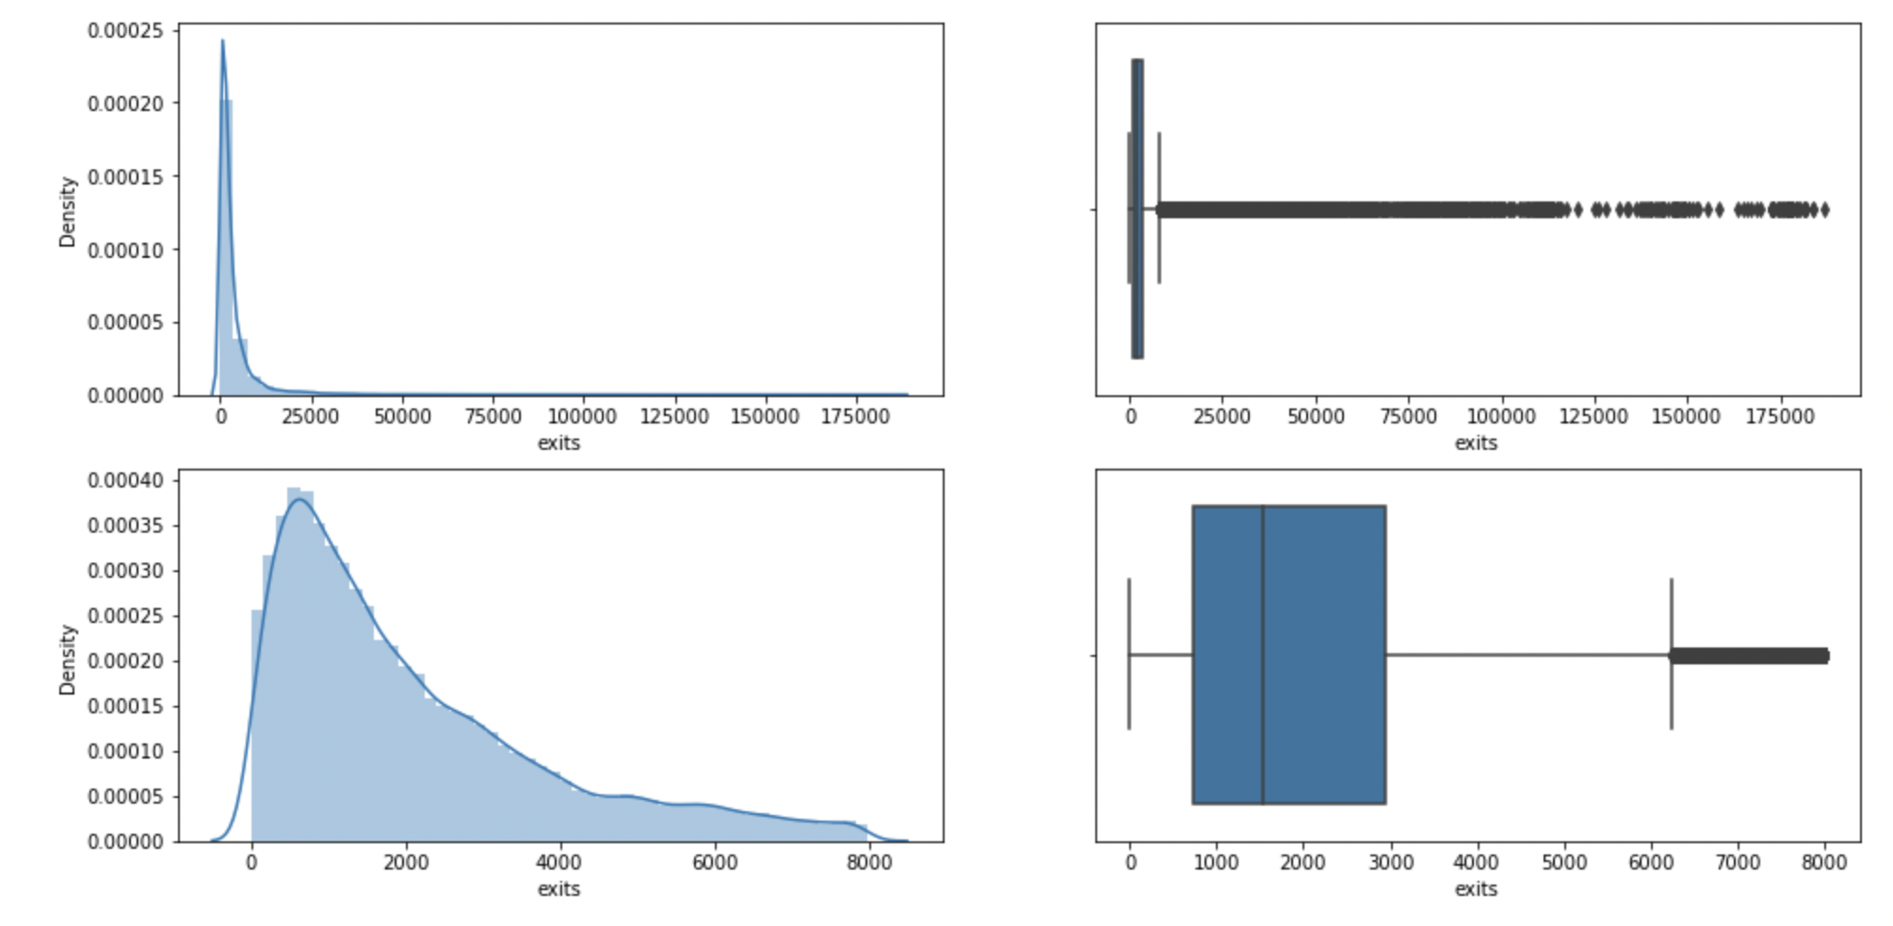
Statistical outlier detection technique
I used Percentile, Standard deviation and IQR as a method of research
IQR :
upper_limit = percentile_75 + 1.5 * iqr
lower_limit = percentile_25 - 1.5 * iqr
Percentile :
percentile_25 = cd['exits'].quantile(0.25)
percentile_75 = cd['exits'].quantile(0.75)
SD :
upper_limit = cd['entries'].mean() + 3*cd['entries'].std()
lower_limit = cd['entries'].mean() - 3*cd['entries'].std()

Slide 14
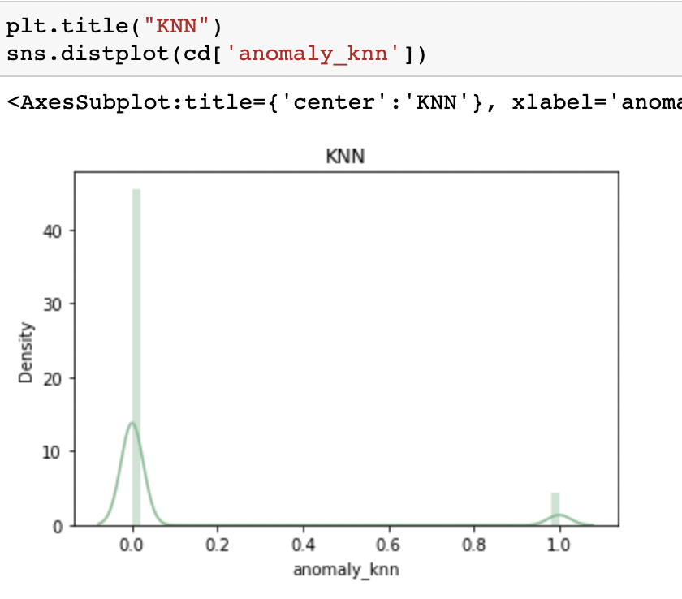
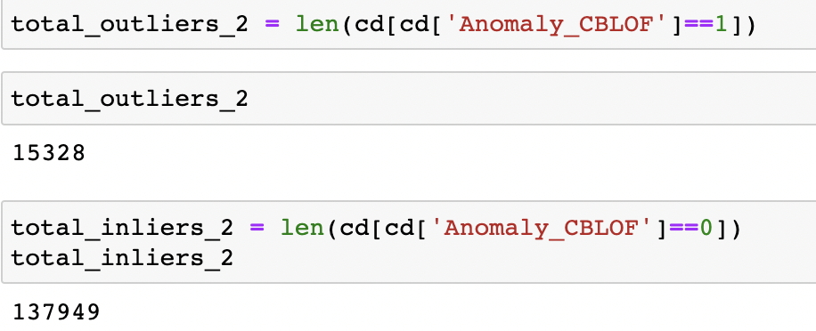
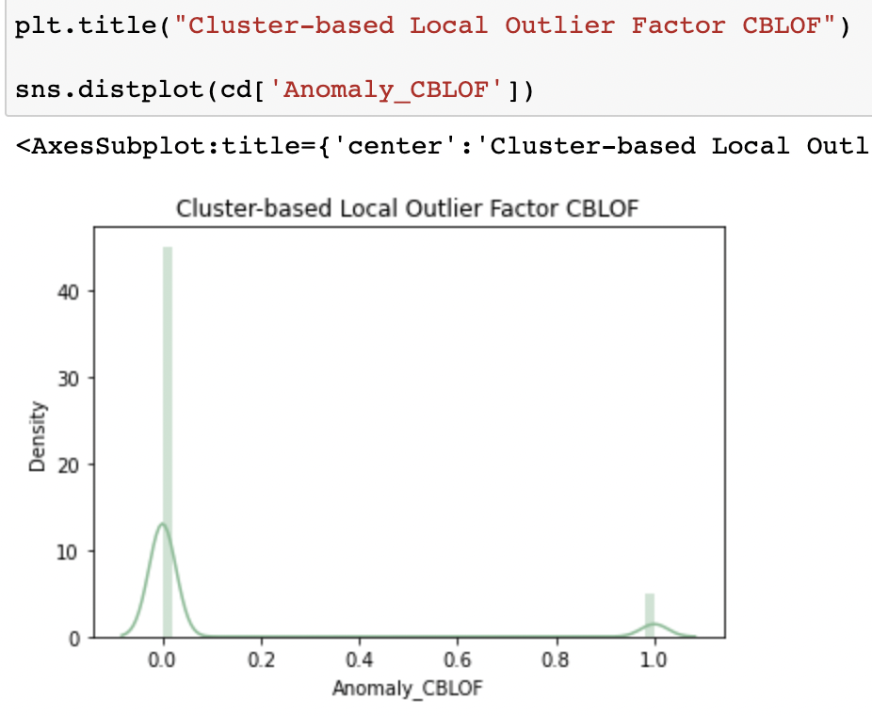
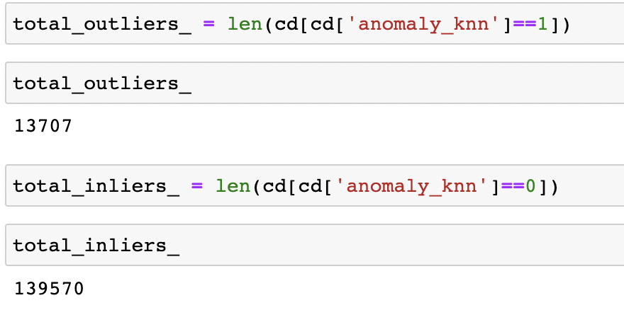
OUTLIER DETECTION USING ABOD, KNN, CLUSTERING
Found the total number of outlier using the above methods :

Slide 15
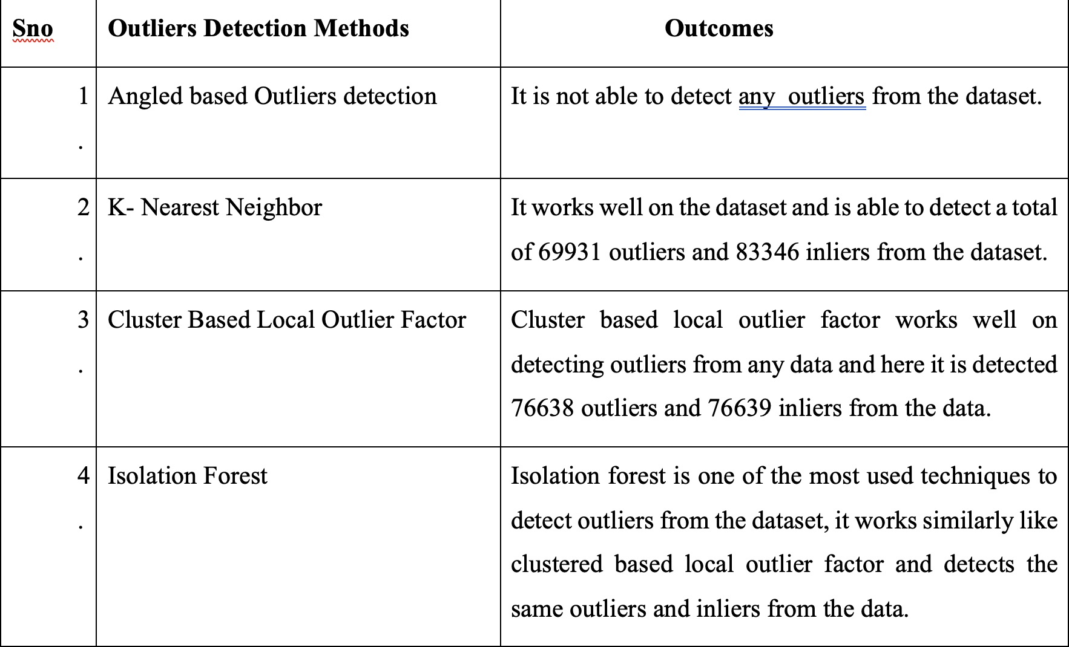
Summary of detected outliers using various techniques

Slide 16
Tableau Features
Data Connections and Modeling
Data Types/ Transformation
Data Loading
Calculated Fields based on Formulas and Functions
Parameters
Visualizations
Deployment of Dashboards

Slide 17
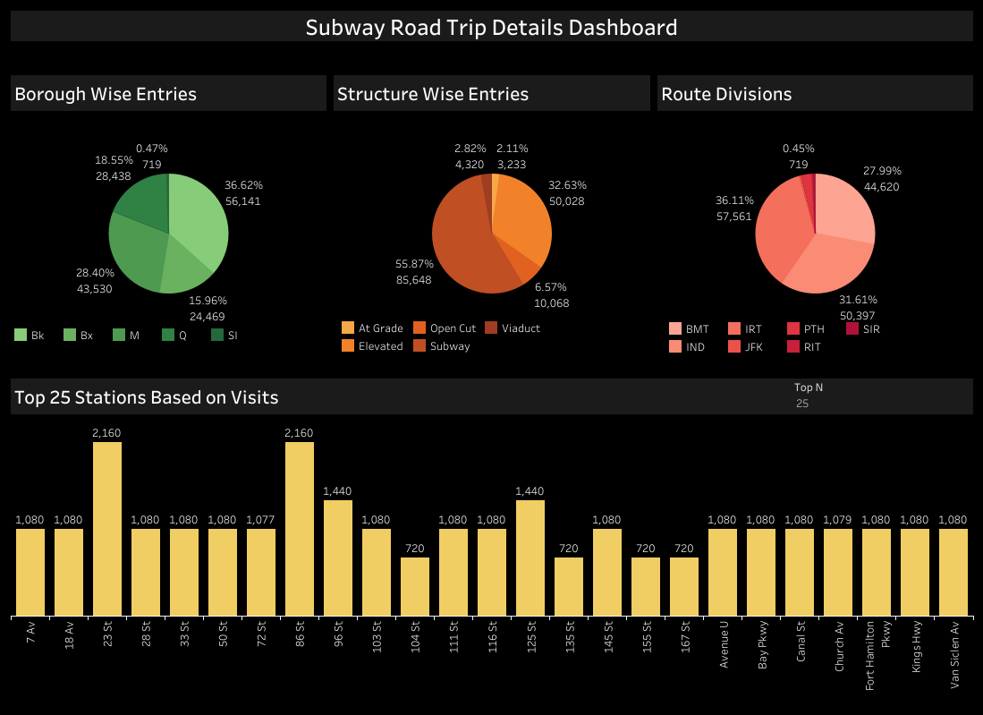
EDA Using Tableau Dashboard

Slide 18
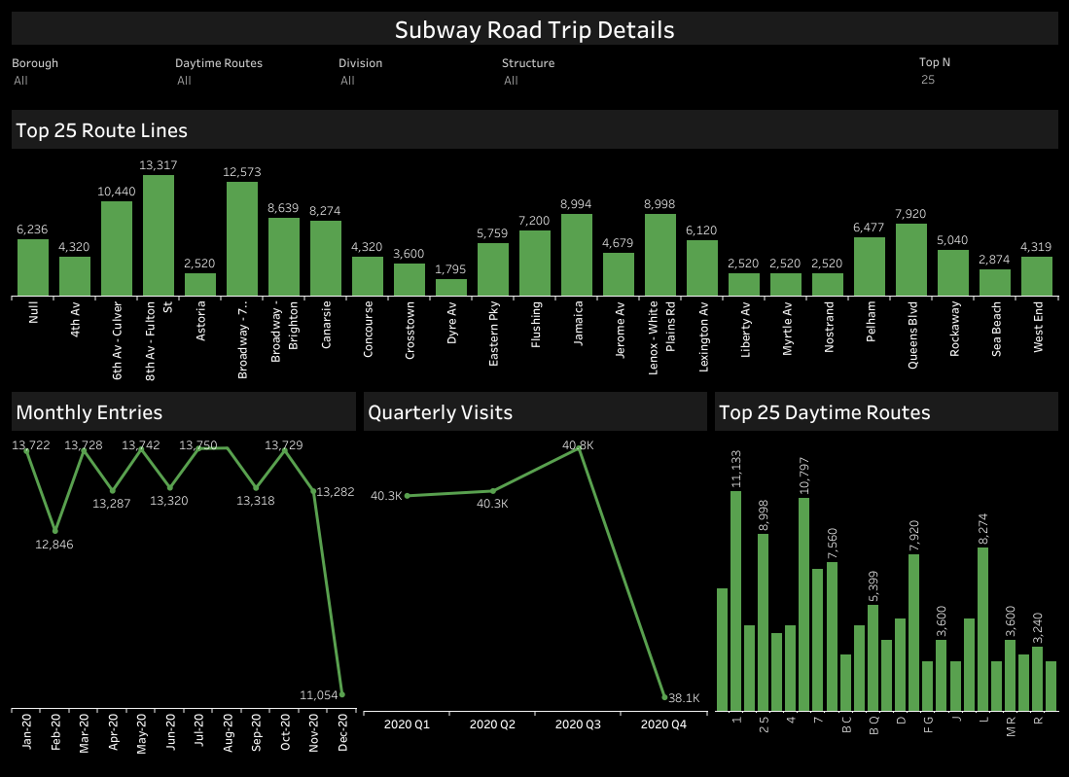
Based on route lines Daytime route

Slide 19
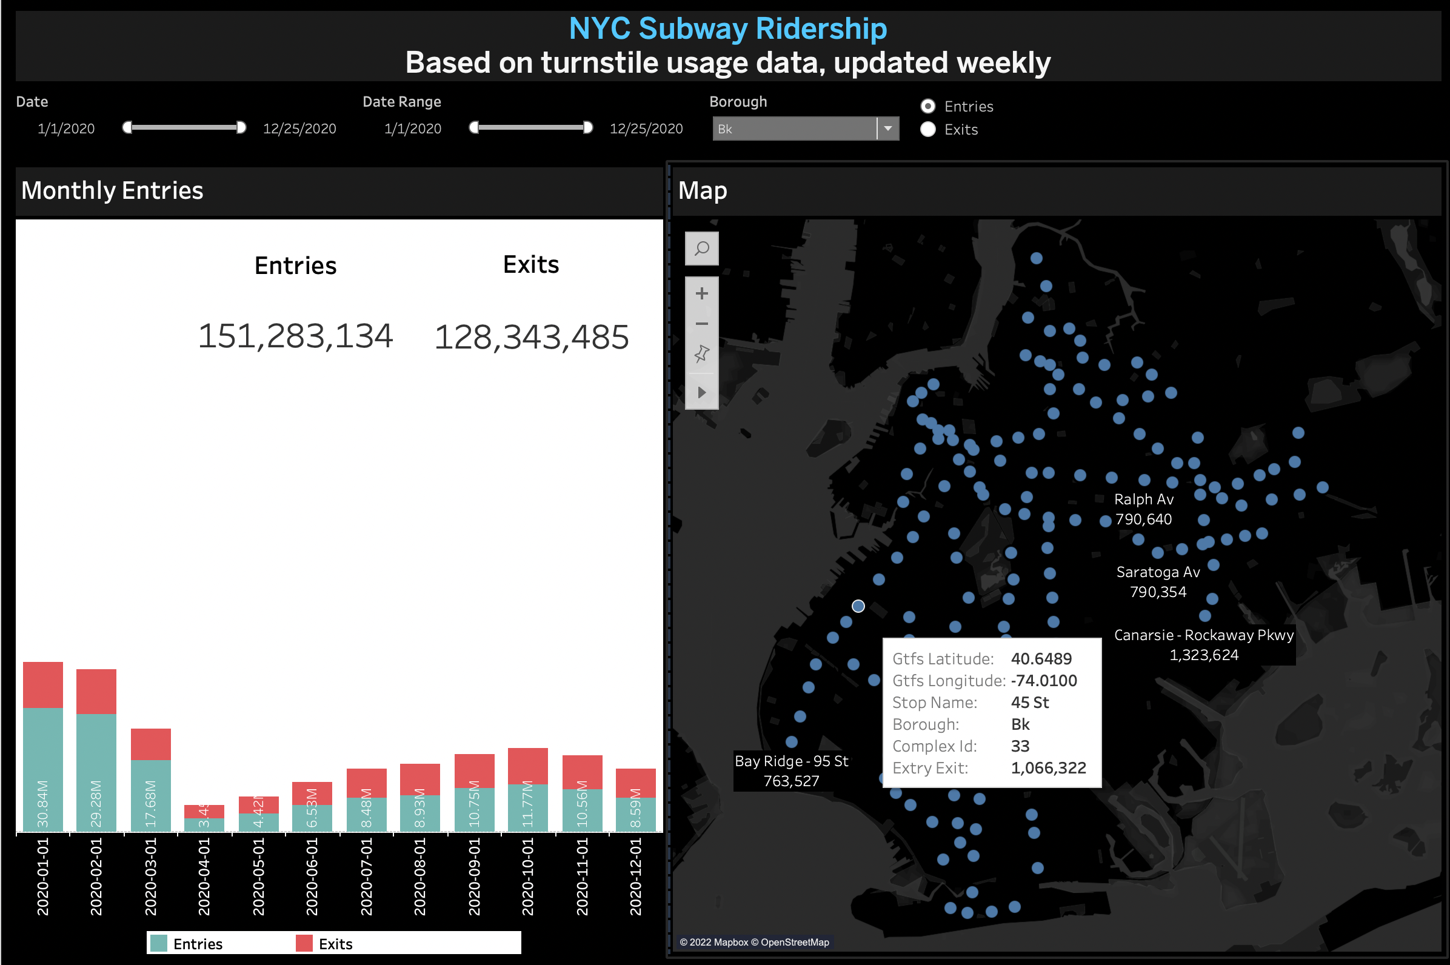
Dashboard based on total Entry/Exit of borough

Slide 20
CONCLUSION
After reading several publications, it became clear that the subway transport world views outlier detection as a crucial duty for ensuring the security of any system or network environment.
The study has shown that it is feasible to forecast daily train-level ridership in a system as vast and intricate as that of New York City without relying on exit data.
The development examples of performance indicators for the subway system that focus on the experiences of the passengers rather than just train movements include excess customer journey time and customer wait time distributions
Improvements can be made on a number of lines as well as during significant service interruptions
Using the platform crowding data, systems can be developed that predict, based on this information and other factors, when the trains will become crowded and how much more crowded they will become
We have to know what is happening at any given time, and that requires measuring data with sensors on all platforms as well as trains to improve overall experience of the NY subway trains

Slide 21


THANKYOU

